Slide 1
Modelling Interventions

Slide 2
Incorporating interventions into models
Interventions acting on model parameters
S
λ
E
γ
I
τ
R
S
λ_{c}
E
γ_{c}
I
τ_{c}
R

Slide 3
Incorporating interventions into models
Interventions affecting the underlying model structure
S
λ
E
γ
I
τ
R
Y
Y
X
Sq
λ₀
Eq
γ
Iq
τ

Slide 4
Interventions acting on model parameters

Slide 5
Basic reproductive number R₀
Average number of new infections caused by 1 infected individual in a completely susceptible population
probability of transmission per contact
R₀ = c • p • d
duration of infectiousness
contacts per unit time

Slide 6
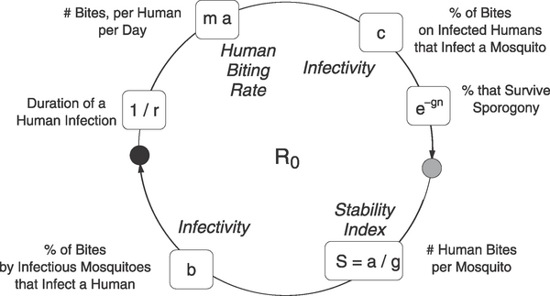
When there is a mosquito involved?

Slide 7
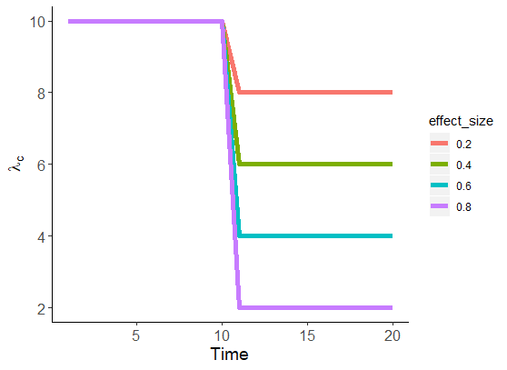
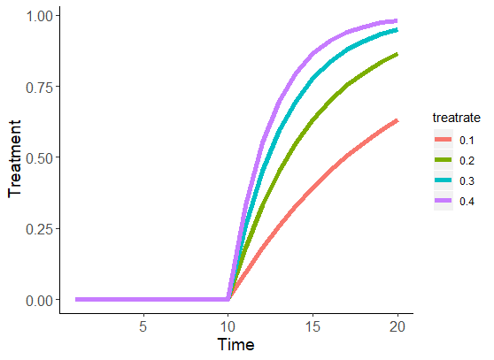
S
λ_{c}
E
γ_{c}
I
τ_{c}
R
λ_{c} = λ * intervention impact measure
τ_{c} = τ ∗ f (improved treatment over time)

Slide 8
Interventions acting on model structure

Slide 9
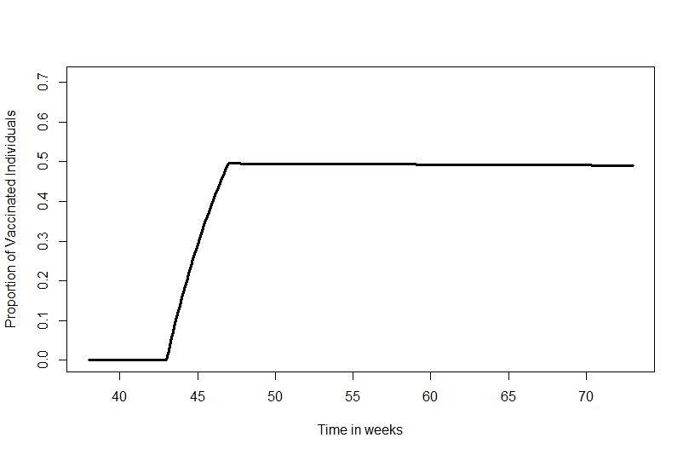
S
λ
E
γ
I
τ
R
v_{c}
V
Maximum vaccination coverage
Speed of vaccination campaign

Slide 10
Lets see it in action
https://moru-raguas.shinyapps.io/interventions_app/

